Slide 1
PROLOG

Slide 2
What is Prolog ?
programming in logic
developed
in 1972 by
Alain Colmeraver and P. Russel

Slide 3
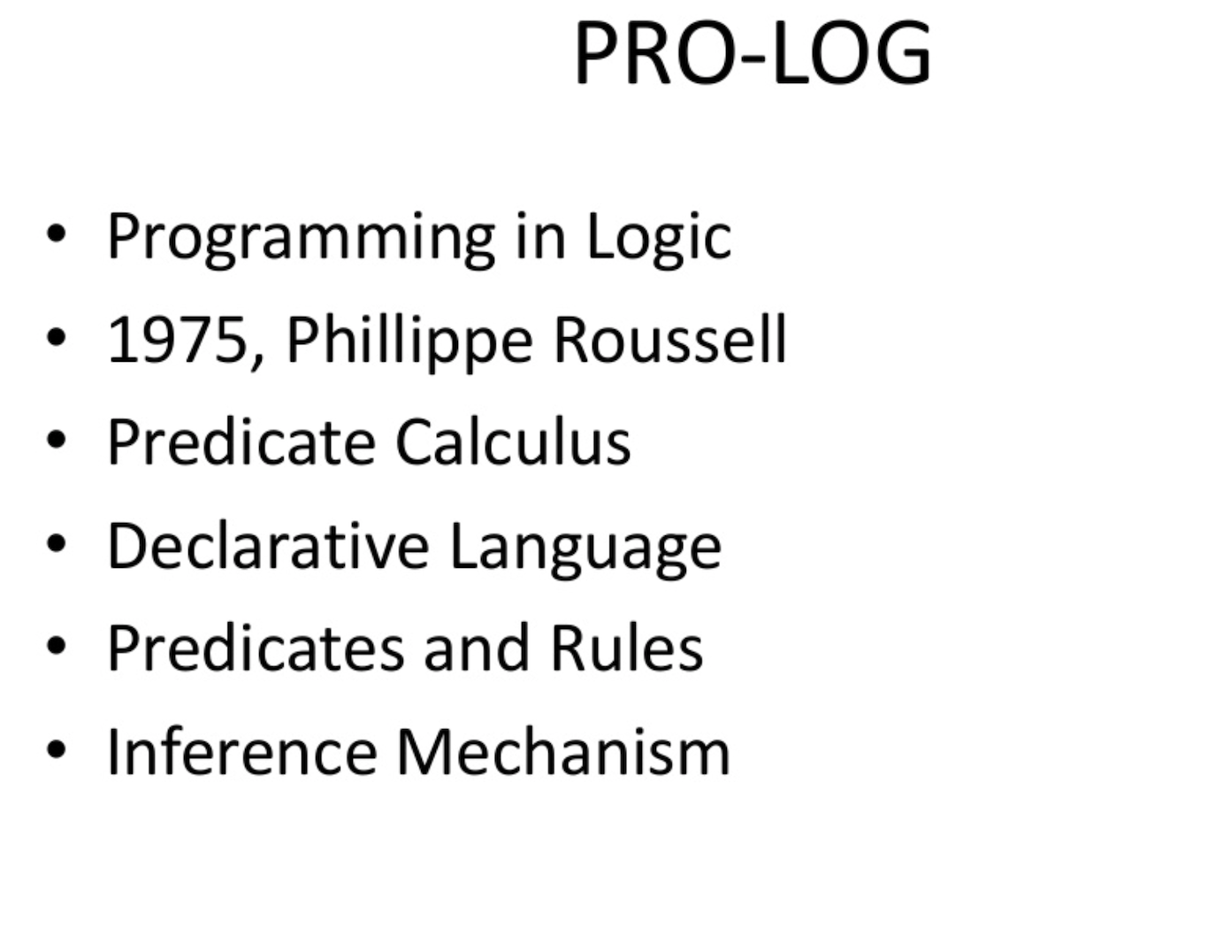

Slide 4
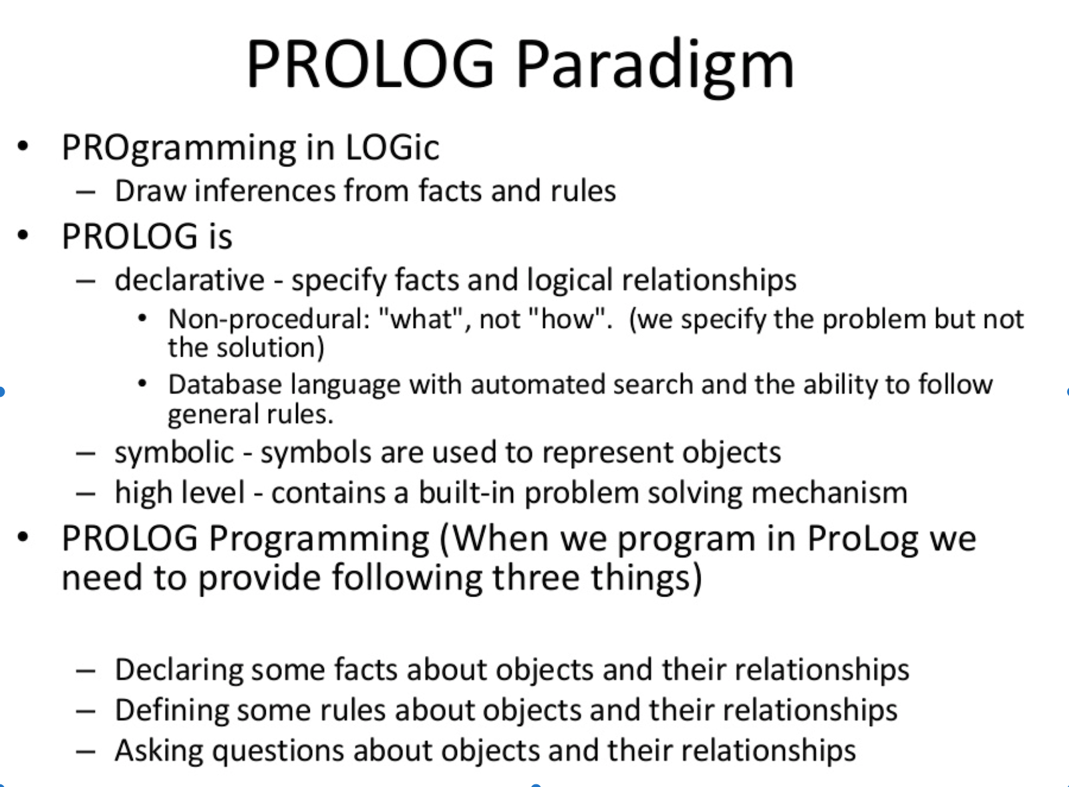

Slide 5
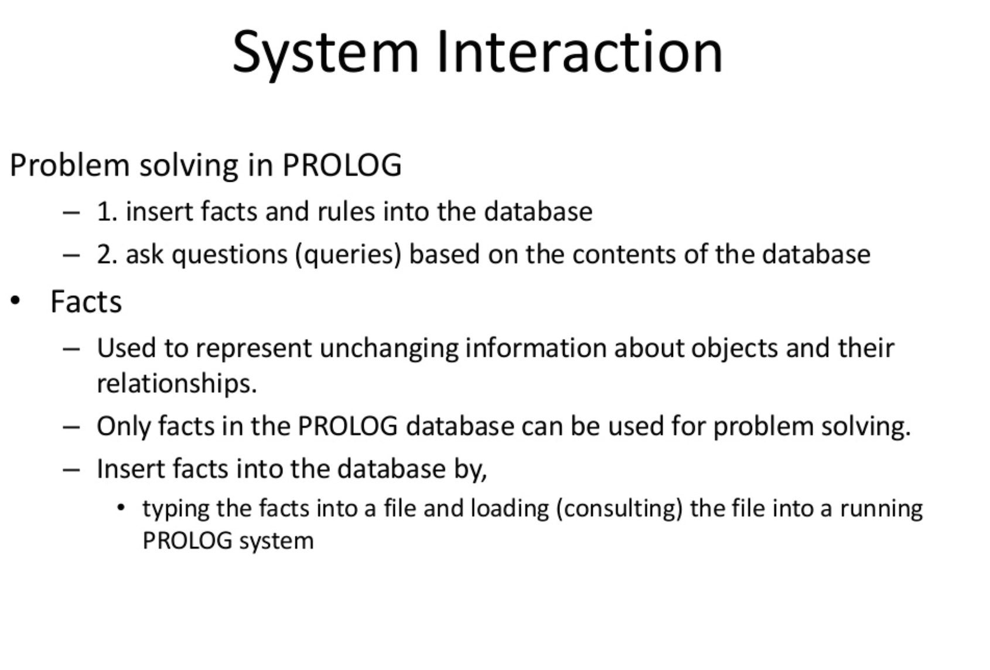

Slide 6
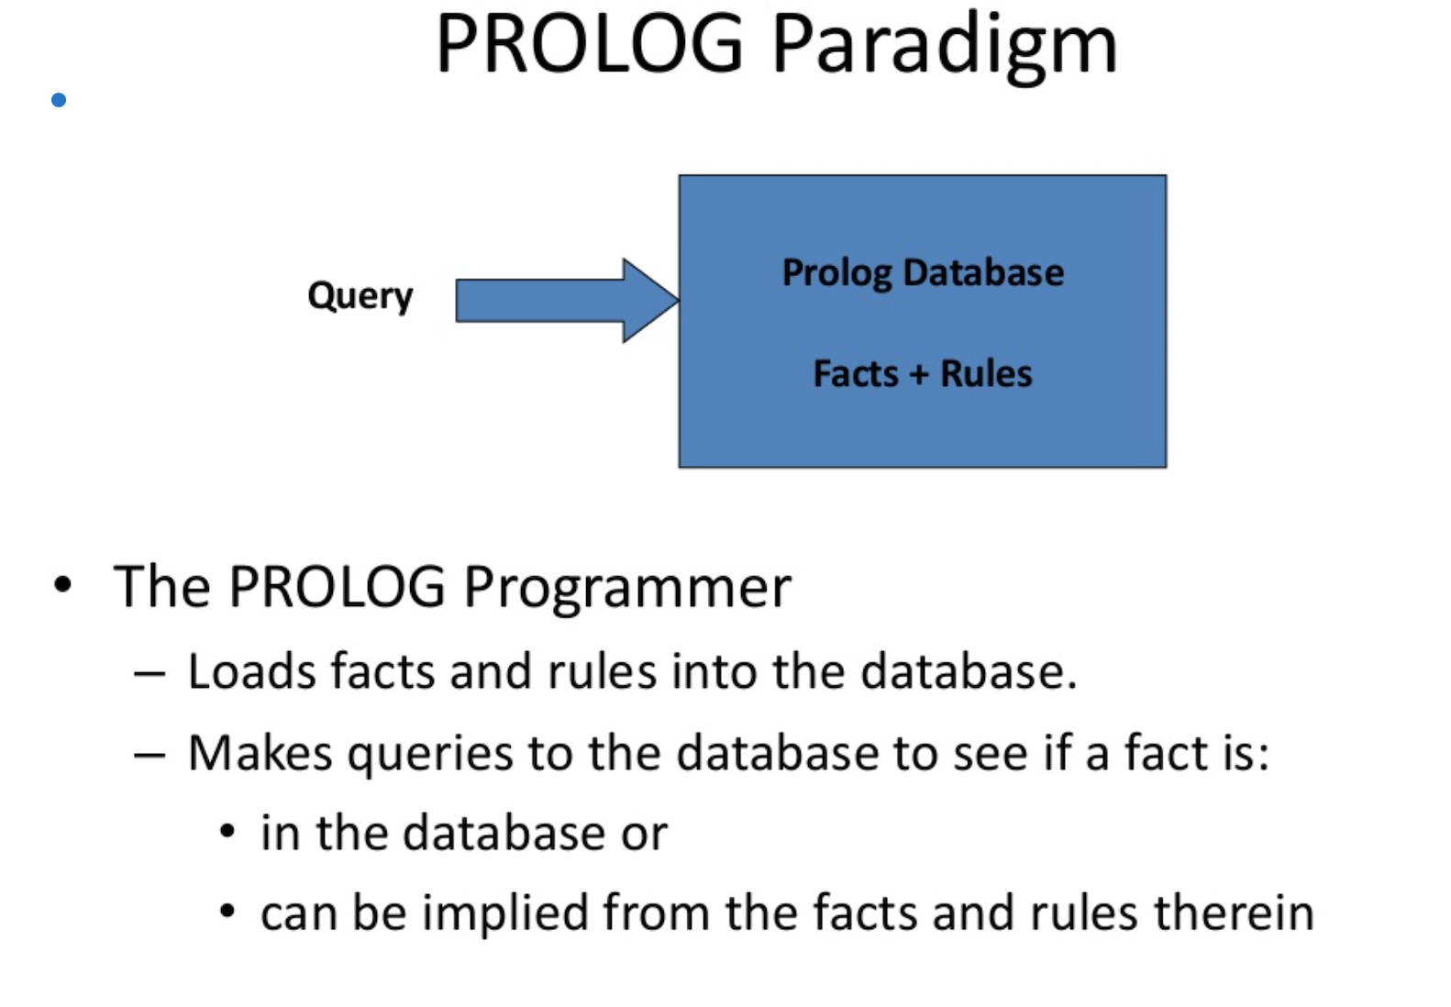

Slide 7
How Prolog is Different ?
Object-oriented language which uses no procedures.
Unique in its ability to infer facts and conclusions from other facts.
Symbolic processing.
The user defines a goal (a problem or objective), and computer find both the procedure and solution.

Slide 8
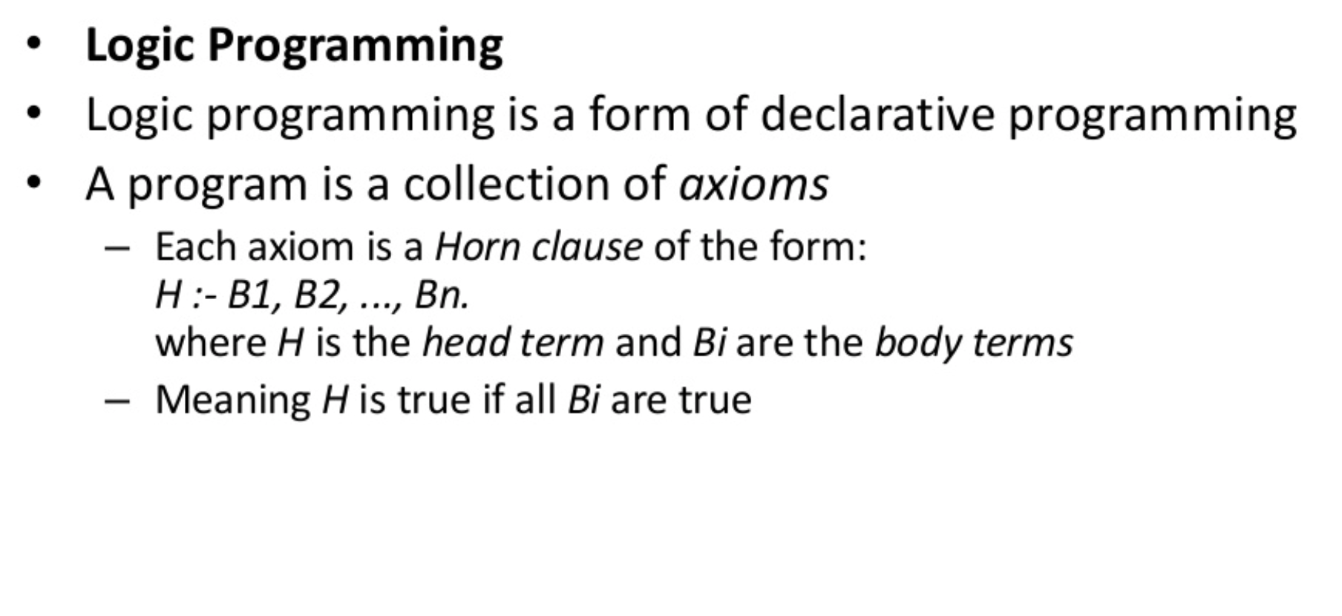

Slide 9
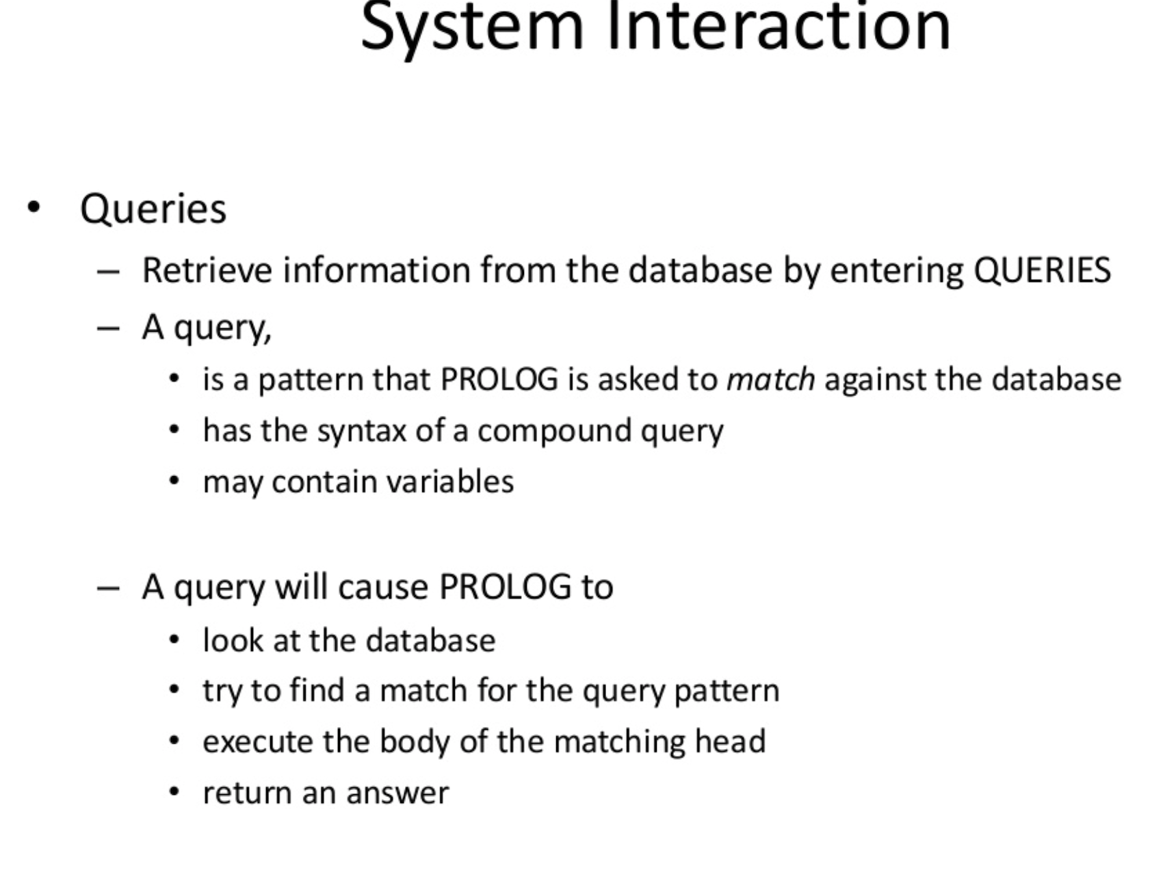

Slide 10
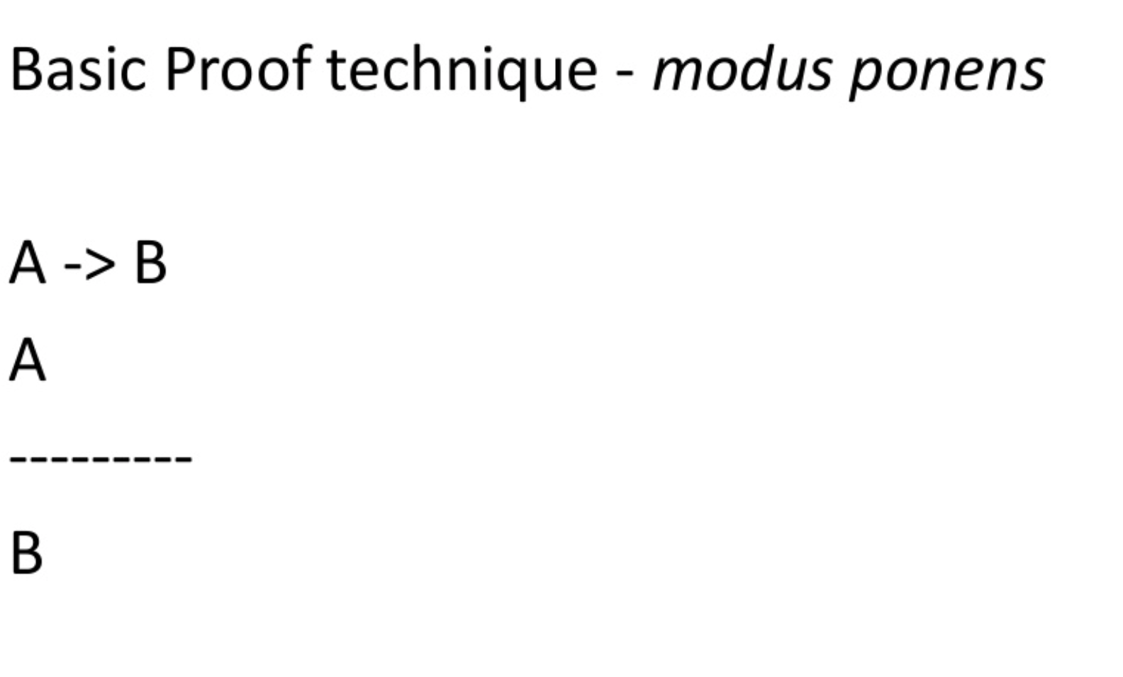

Slide 11
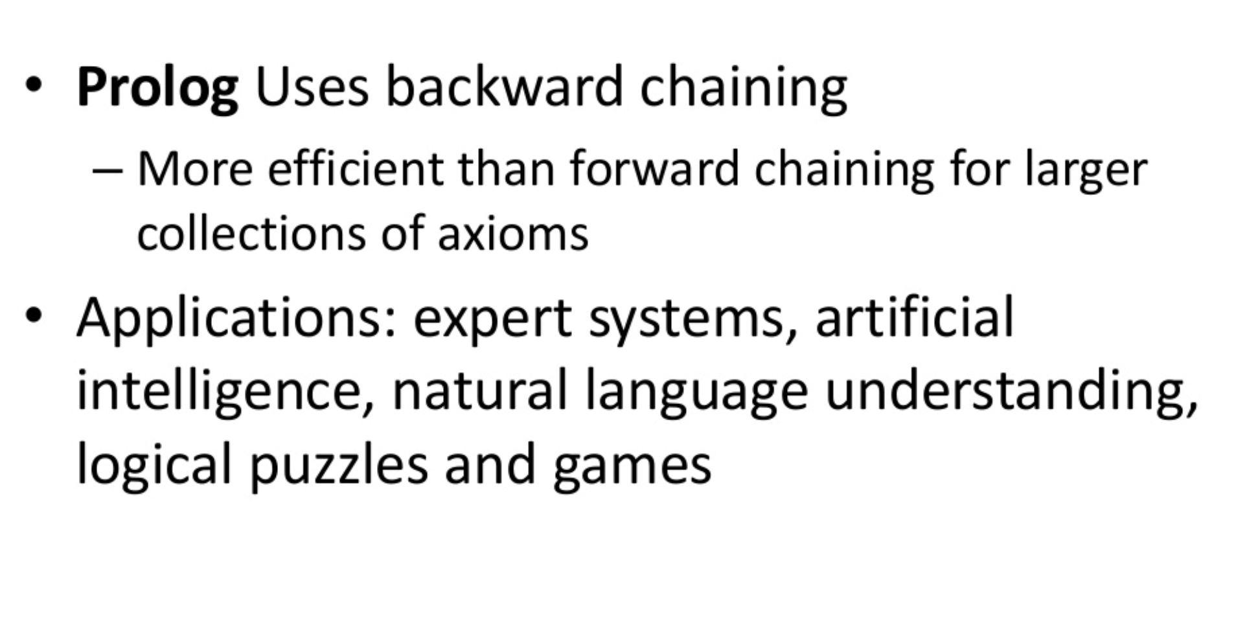

Slide 12
Power of Prolog
Most efficient in formal reasoning. Useful for almost any application that requires formal reasoning.
Use heuristics to solve problems.
System developed and maintained by knowledge engineers.

Slide 13
Application for Prolog
Expert systems,
Natural language processing,
Robotics,
Game playing, and
Simulations

Slide 14
Using Turbo Prolog
After loading Turbo Prolog/SWI four windows will appear
Editor Window
Used to create or edit programs
Dialog Window
Output will be displayed
Message Window
Keeps you up to date on processing activity
Trace Window
Useful for finding problems in the programs

Slide 15
Defining Relations by facts
Whole family tree is defined by the following relation
parent( pam, bob).
parent( tom, bob).
parent( tom, liz).
parent(bob, ann).
parent (bob, pat).
parent(pat, jim).
pam
tom
bob
liz
ann
pat
jim

Slide 16
Defining relations by facts
Questions:
Is Bob a parent of Pat?
parent( bob, pat).
parent( liz, pat).
parent( tom, ben).
Who is Liz’s parent?
parent( X, liz).
Who are Bob’s children?
parent( bob, X).
pam
tom
bob
liz
ann
pat
jim

Slide 17
Defining relations by facts
pam
tom
Questions:
Who is a parent of whom?
Find X and Y such that X is a parent of Y.
?- parent( X, Y).
Who is a grandparent of Jim?
?- parent( Y, jim),
parent( X, Y).
bob
liz
ann
pat
jim
X
parent
Y
grandparent
parent
jim

Slide 18
Defining relations by facts
Questions:
Who are Tom’s grandchildren?
?- parent( tom, X),
parent( X, Y).
Do Ann and Pat have a common parent?
?- parent( X, ann),
parent( X, pat).
tom
pam
bob
liz
ann
pat
jim

Slide 19
Defining relations by facts
It is easy in Prolog to define a relation.
The user can easily query the Prolog system about relations defined in the program.
A Prolog program consists of clauses. Each clause terminates with a full stop.
The arguments of relations can be
Atoms: concrete objects or constants
Variables: general objects such as X and Y

Slide 20
Defining Relations by facts
Questions to the system consist of one or more goals.
An answer to a question can be either positive (succeeded) or negative (failed).
If several answers satisfy the question then Prolog will find as many of them as desired by the user.

Slide 21
Defining relations by rules
Facts:
female( pam). % Pam is female
male( tom). % Tom is male
male( bob).
female( liz).
female( ann).
female( pat).
male( jim).
pam
tom
bob
liz
ann
pat
jim

Slide 22
Defining relations by rules
Define the “offspring” relation:
Fact: offspring( liz, tom).
Rule: offspring( Y, X) :-
parent( X, Y).
For all X and Y, Y is an offspring of X if X is a parent of Y.
pam
tom
bob
liz
ann
pat
jim

Slide 23
Defining relations by rules
Rules have:
A condition part (body)
the right-hand side of the rule
A conclusion part (head)
the left-hand side of the rule
Example:
offspring( Y, X) :- parent( X, Y).
The rule is general in the sense that it is applicable to any objects X and Y.
A special case of the general rule:
offspring( liz, tom) :- parent( tom, liz).
?- offspring( liz, tom).
?- offspring( X, Y).

Slide 24
Defining relations by rules
Define the “mother” relation:
mother( X, Y) :- parent( X, Y), female( X).
For all X and Y,
X is the mother of Y if
X is a parent of Y and
X is a female.
female
X
X
parent
offspring
parent
mother
Y
Y

Slide 25
Defining relations by rules
Define the “grandparent” relation:
grandparent( X, Z) :-
parent( X, Y), parent( Y, Z).
X
parent
Y
grandparent
parent
Z

Slide 26
Defining relations by rules
Define the “sister” relation:
sister( X, Y) :-
parent( Z, X), parent( Z, Y), female(X).
For any X and Y,
X is a sister of Y if
(1) both X and Y have the same parent, and
(2) X is female.
?- sister( ann, pat).
?- sister( X, pat).
?- sister( pat, pat).
Pat is a sister to herself?!
Z
parent
parent
female
X
Y
sister

Slide 27
Defining relations by rules
To correct the “sister” relation:
sister( X, Y) :-
parent( Z, X), parent( Z, Y), female(X),
different( X, Y).
different (X, Y) is satisfied if and only if X and Y are not equal.
Z
parent
parent
female
X
Y
sister

Slide 28
Defining relations by rules
Prolog clauses consist of
Head
Body: a list of goal separated by commas (,)
Prolog clauses are of three types:
Facts:
declare things that are always true
facts are clauses that have a head and the empty body
Rules:
declare things that are true depending on a given condition
rules have the head and the (non-empty) body
Questions:
the user can ask the program what things are true
questions only have the body

Slide 29
Defining relations by rules
A variable can be substituted by another object.
Variables are assumed to be universally quantified and are read as “for all”.
For example:
hasachild( X) :- parent( X, Y).
can be read in two way
(a) For all X and Y,
if X is a parent of Y then X has a child.
(b) For all X,
X has a child if there is some Y such that X is a parent of Y.

Slide 30
Recursive rules
Define the “predecessor” relation
X
X
parent
predecessor
parent
Y
Y1
parent
predecessor
X
Y2
parent
Y
predecessor
parent
parent
Z
Z

Slide 31
Recursive rules
Define the “predecessor” relation
predecessor( X, Z):-
parent( X, Z).
predecessor( X, Z):-
parent( X, Y),
predecessor( Y, Z).
For all X and Z,
X is a predecessor of Z if
there is a Y such that
(1) X is a parent of Y and
(2) Y is a predecessor of Z.
?- predecessor( pam, X).
X
parent
Y1
predecessor
predecessor
:
Z

Slide 32
Recursive rules
% The family program.
parent( pam, bob).
parent( tom, bob).
parent( tom, liz).
parent( bob, ann).
parent( bob, pat).
parent( pat, jim).
female( pam).
female( liz).
female( ann).
female( pat).
male( tom).
male( bob).
male( jim).
offspring( Y, X) :-
parent( X, Y).
mother( X, Y) :-
parent( X, Y),
female( X).
grandparent( X, Z) :-
parent( X, Y),
parent( Y, Z).
sister( X, Y) :-
parent( Z, X),
parent( Z, Y),
female( X),
different( X, Y).
predecessor( X, Z) :- parent( X, Z).
predecessor( X, Z) :- parent( X, Y),
predecessor( Y, Z).

Slide 33
Recursive rules
Procedure:
In figure, there are two “predecessor relation” clauses.
predecessor( X, Z) :- parent( X, Z).
predecessor( X, Z) :- parent( X, Y), predecessor( Y, Z).
Such a set of clauses is called a procedure.
Comments:
/* This is a comment */
% This is also a comment

Slide 34
How Prolog answers questions
To answer a question, Prolog tries to satisfy all the goals.
To satisfy a goal means to demonstrate that the goal is true, assuming that the relations in the program is true.
Prolog accepts facts and rules as a set of axioms, and the user’s question as a conjectured theorem.
Example:
Axioms: All men are fallible .
Socrates is a man.
Theorem: Socrates is fallible.
For all X, if X is a man then X is fallible.
fallible( X) :- man( X)
man( socrates).
?- fallible( socrates).

Slide 35
How Prolog answers questions
?- predecessor( tom, pat).
predecessor( X, Z) :- parent( X, Z). % Rule pr1
predecessor( X, Z) :- parent( X, Y), % Rule pr2
predecessor( Y, Z).
(1) parent( bob, pat) ➔ predecessor( bob, pat)
Form parent( bob, pat) it follows that predecessor( bob, pat), by rule pr1.
(2) parent( tom, bob) is fact.
(3) parent( tom, bob) and parent( bob, pat) ➔
predecessor( tom, pat).
Using the fact and the derived fact parent( bob, pat) we can conclude predecessor( tom, pat).
pam
tom
bob
liz
ann
pat
jim

Slide 36
How Prolog answers questions
?- predecessor( tom, pat).
predecessor( X, Z) :- parent( X, Z). % Rule pr1
predecessor( X, Z) :- parent( X, Y), % Rule pr2
predecessor( Y, Z).
How dose the Prolog system actually find a proof sequence?
Prolog first tries that clause which appears first in the program. (rule pr1)
Now, X= tom, Z = pat.
The goal predecessor( tom, pat) is then replace by parent( tom, pat). (see Figure )
There is no clause in the program whose head matches the goal parent( tom, pat).
Prolog backtracks to the original goal in order to try an alternative way (rule pr2).
pam
tom
bob
liz
ann
pat
jim

Slide 37
How Prolog answers questions
?- predecessor( tom, pat).
predecessor( X, Z) :- parent( X, Z). % Rule pr1
predecessor( X, Z) :- parent( X, Y), % Rule pr2
predecessor( Y, Z).
Apply rule pr2, X = tom, Z = pat, but Y is not instantiated yet.
The top goal predecessor( tom, pat) is replaces by two goals:
parent( tom, Y)
predecessor( Y, pat)
The first goal matches one of the facts. (Y = bob)
The remaining goal has become
predecessor( bob, pat)
Using rule pr1, this goal can be satisfied.
predecessor( bob, pat) :- parent( bob, pat)
pam
tom
bob
liz
ann
pat
jim

Slide 38
How Prolog answers questions
predecessor( tom, pat)
By rule pr1
By rule pr2
parent( tom, pat)
parent( tom, Y)
predecessor( Y, pat)
no
Y = bob
By fact parent
( tom, bob)
The top goal is satisfied when a path is found from the root node to a leaf node labeled ‘yes’.
The execution of Prolog is the searching for such path.
predecessor( bob, pat)
By rule pr1
parent( bob, pat)
yes

Slide 39
Trace
predecessor( X, Z) :- parent( X, Z). % Rule pr1
predecessor( X, Z) :- parent( X, Y), % Rule pr2
predecessor( Y, Z).
predecessor( tom, pat)
By rule pr1
By rule pr2
parent( tom, pat)
parent( tom, Y)
predecessor( Y, pat)
| ?- predecessor( tom, pat).
1 1 Call: predecessor(tom,pat) ?
2 2 Call: parent(tom,pat) ?
2 2 Fail: parent(tom,pat) ?
2 2 Call: parent(tom,_79) ?
2 2 Exit: parent(tom,bob) ?
3 2 Call: predecessor(bob,pat) ?
4 3 Call: parent(bob,pat) ?
4 3 Exit: parent(bob,pat) ?
3 2 Exit: predecessor(bob,pat) ?
1 1 Exit: predecessor(tom,pat) ?
true ?
By fact parent( tom, bob)
no
Y = bob
predecessor( bob, pat)
By rule pr1
parent( bob, pat)
yes

Slide 40
1.5 Declarative and procedural meaning of programs
Two levels of meaning of Prolog programs:
The declarative meaning
concerned only with the relations defined by the program
determines what will be the output of the program
The programmer should concentrate mainly on the declarative meaning and avoid being distracted by the executional details.
The procedural meaning
determines how this output is obtained
determines how the relations are actually evaluated by the Prolog system
The procedural aspects cannot be completely ignored by the programmer for practical reasons of executional efficiency.

Slide 41
Exercise
Exercise 1.7
(a) ?- mother( pam, bob).
(b) ?- grandparent( bob, jim).
Try to understand how Prolog derives answers to the following questions, using the program of Figure 1.8. (trace)
Try to draw the corresponding derivation diagrams in the style of Figures 1.9 to 1.11.
Will any backtracking occur at particular questions?

Slide 42
Trace and Notrace
| ?- trace.
The debugger will first creep -- showing everything (trace)
(15 ms) yes
{trace}
| ?- predecessor( X, Z).
1 1 Call: predecessor(_16,_17) ?
2 2 Call: parent(_16,_17) ?
2 2 Exit: parent(pam,bob) ?
1 1 Exit: predecessor(pam,bob) ?
X = pam
Z = bob ? ;
1 1 Redo: predecessor(pam,bob) ?
2 2 Redo: parent(pam,bob) ?
2 2 Exit: parent(tom,bob) ?
1 1 Exit: predecessor(tom,bob) ?
X = tom
Z = bob ? ;
…
X = bob
Z = jim
1 1 Redo: predecessor(bob,jim) ?
3 2 Redo: predecessor(pat,jim) ?
4 3 Call: parent(pat,_144) ?
4 3 Exit: parent(pat,jim) ?
…
4 3 Fail: parent(jim,_17) ?
4 3 Call: parent(jim,_144) ?
4 3 Fail: parent(jim,_132) ?
3 2 Fail: predecessor(jim,_17) ?
1 1 Fail: predecessor(_16,_17) ?
(266 ms) no
{trace}
| ?- notrace.
The debugger is switched off
yes

